Slide 1
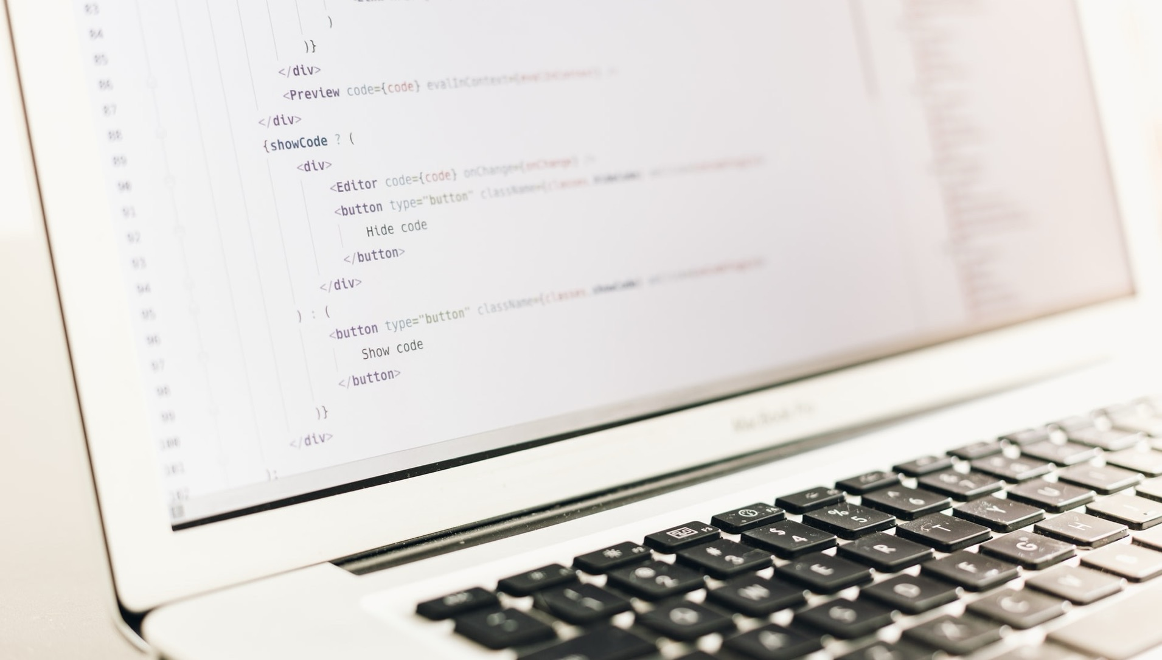

INTRODUCTION
To Security
A Course Designed Specifically for FDIC Risk Management Examiners
Copyright Hill Associates

Slide 2
Getting Started
Please comment, feed back, and advise.
We’re very interested in your ideas, thoughts, and feelings about this course, the method, and the material itself.
You can get to us any way you like: Email to matt@hillvt.com or written/oral comments to me.
Housekeeping
Let’s agree on some rules for the week...

Slide 3
Introductions
Please tell us about you!
Where do you live and work?
What’s your role?
What do you do for fun?
What would you like to take away from this course?
How comfortable do you feel with InfoSec already?
As for me, I’m Matt Kolon, a Senior MTS at Hill Associates
I’m a long-time networking and telecom geek and bank IT guy
I’ve worked for Cisco, Juniper, and Brocade as well as Hill Associates
From 2005 to 2017 I lived in 香港, 北京, and 東京
Now I live in Underhill, Vermont where I ski and ride my bikes a lot.
This week, I’d like to better understand examiners’ views on InfoSec

Slide 4
Please Bookmark This!
https://class.hillvt.com/
then follow the link to our class: FDIC Introduction to Security
https://class.hillvt.com/2025/07/08/FDIC-ITS.html
We’ll use this page to post questions, answers, ideas, problems, jokes, and anything else that seems useful.
I’ll leave it up for a couple of weeks after class.
If you want to contribute a link, just tell me.

Slide 5
Program Introduction
Chapter 1

Slide 6
Overall Goals
Understand the big-picture Information Security (InfoSec) concepts and apply them to banking situations
Focus on cybersecurity and resilience
Gain an understanding of the underlying relationships between interconnecting concepts related to risk management and information security
Get a handle on the terminology
Have fun

Slide 7
Specific Course Objectives
Explain Information Security using baseline terminology and concepts
Describe regulatory guidance related to information security
Discuss security policy design and implementation
Explain the role of bank management and oversight responsibilities
Discuss security management practices
Describe physical and operations security

Slide 8
Specific Course Objectives (continued)
Explain network controls testing, auditing, and monitoring
Describe secure network design, encryption, access control, and authentication
Discuss firewall implementation and concepts
Describe vendor management security
Explain basic types of security issues and mitigation strategies

Slide 9
Some Security Predictions for 2025
AI is the hot topic for attack, defense and new risks
Data privacy concerns increase as legislation landscape is muddled
Ransomware will continue to evolve
Nation-state attacks will continue to grow and disrupt global stability
MFA attacks will continue
Supply chain attacks will increase
Is it time to consider post quantum encryption?

Slide 10
Exercise
At your table discuss the major cybersecurity threats you are concerned about and create a list of your top 3 concerns. Your concerns maybe related to banking, general business, society, personal or the nation.
Where did these ideas and impressions come from?

Slide 11


Information Security Introduction
Chapter 2

Slide 12
Objectives
Upon completing this chapter, you will be able to
Define Information Security
Compare Information Security and Cybersecurity
Describe what we are protecting
List the elements of an Information Security Plan
Identify the Information Security Requirements and Resources for banks

Slide 13
Information Security
Like corporate security, or quality assurance within manufacturing, it is a process, not a one-time implementation
To mitigate risk, plan for “events”
Requires the integration of people, processes and technology
Events consistently have shown it is hard, but necessary
Security strategies should include prevention, detection, and response
People
Process
Technology

Slide 14
Information Security: Part 364 Appendix B
Information security is the process by which a financial institution protects the creation, collection, storage, use, transmission, and disposal of sensitive information, including the protection of hardware and infrastructure used to store and transmit such information
Information security exists to provide protection from malicious and non-malicious actions that increase the risk of adverse effects on earnings, capital, or enterprise value
Goal is to prevent:
Disclosure of information to unauthorized individuals
Unavailability or degradation of services
Misappropriation or theft of information or services
Modification or destruction of systems or information
Records that are not timely, accurate, complete, or consistent
Notes:
CFR: The master rulebook for U.S. federal regulations
12 CFR: The section devoted to banking regulations
Part 364: FDIC standards for safety and soundness
Appendix B: Specific security guidelines under those standards

Slide 15
Cyber Security or Cybersecurity
Is a subset of Information Security protecting digital assets from cyber attacks
Area of growing concern as more assets become digital and threats increase
FDIC has increased focus on cybersecurity in recent years
NIST Cybersecurity framework
FFIEC Cybersecurity Assessment Tool (CAT), sunsetting in August 2025
Part of the overall Information Security Plan

Slide 16

Remember the Information Security Triad from ITEC?
Integrity
Confidentiality
Availability
Notes:
Privacy is a human right.
Secrecy is an intentional act.
Confidentiality is a technical and procedural control that can support both.

Slide 17
Information Security Program
Part 364 Appendix B states each institution must:
Design its information security program to control the identified risks
Consider whether the following security measures are appropriate for the institution and, if so, adopt those measures the institution concludes are appropriate
Complexity of the Information Security program will vary based on:
Sensitivity of the information
Scope of institution services
Size of the institution

Slide 18
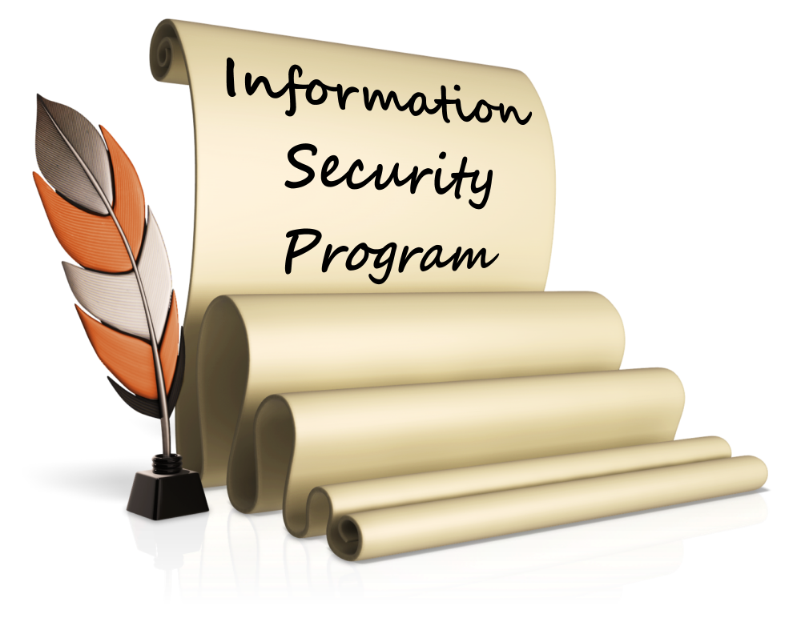
Information Security Program Review
Governance
Risk Identification
Risk Mitigation
Monitoring/Detection
Incident Response
Recovery
Program should include ongoing
Testing, Review and Update

Slide 19
Sample Information Security Program Elements
Access controls
Encryption
Review of security impact in any system changes
Personnel checks and reviews
Persistent monitoring
Incident response programs
Data and system continuity plans

Slide 20
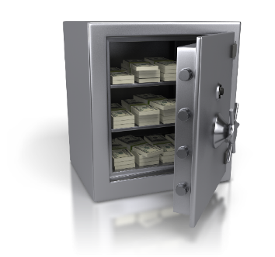
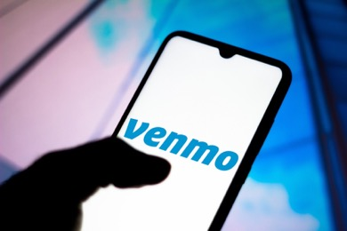
Let’s Start at the Very Beginning
Information is one of a financial institution’s most important assets
Loss (or compromise) of critical information is catastrophic
Protection of information assets is required by law and protects the institution’s reputation
From Cash To Data

Slide 21
Banking IT Evolution
Batch processing to real time processing
Custom code in house to purchased applications to outsourcing
Networking of branches and ATMs
From local to national to global—the Internet
Online banking
Mobile banking
New payments systems
New data driven products and decision tools
Greater reliance on automation and integration
Threats change at every stage in the evolution

Slide 22
Information Security Requirements for Banks
Regulatory guidance
Gramm Leach Bliley Act (GLBA)
Fair and Accurate Credit Transactions Act (FACTA)
FDIC 12 CFR Parts 334 and 364
FDIC Financial Institution Letters (FIL)
Resources
FFIEC IT Examination Handbooks
NIST Cybersecurity Framework
FFIEC Cybersecurity Guidance

Slide 23
Summary
Information Security and Cybersecurity definitions
CIA Triad
Elements of an Information Security Plan
Information Security Requirements and Resources for banks

Slide 24

InfoSec: The Banking and Regulatory Compliance Perspective
Chapter 3

Slide 25
Chapter Objectives
Upon completing this chapter, you will be able to
Describe the basics of the Gramm-Leach-Bliley Act
Describe the basics of the Fair and Accurate Credit Transactions Act
Discuss the concept of compliance and how it fits into security
Discuss concepts associated with governance-based procedures versus technology-based procedures
Identify several best practice considerations and references

Slide 26
What Are We Afraid Of?
Compromise of personal data
Identity theft
Personal data gathering
Lack of control of personal data use
Intellectual Property theft
Interference by a foreign power
Cyberstalking
Infrastructure damage
Any others?

Slide 27
Security Events In the News
Agentic AI and deepfake phishing
Smishing from everywhere
State-sponsored hacking groups
Malware
What else?
Notes:
https://www.techradar.com/pro/security/dangerous-android-malware-targets-us-bank-apps-50-000-people-already-affected-make-sure-youre-not-next
https://krebsonsecurity.com/2025/04/china-based-sms-phishing-triad-pivots-to-banks/

Slide 28
Computer-Security Incidents
RMS IT and Operations Examiner Resources SharePoint site: General guidance for examinations including Risk Advisories (RAs) and Technical Examination Aids (TEAs) (FDIC-only)
Resources for Reporting Incidents (FDIC only)
RMS IT and Operations Examiner Resources SharePoint sites: Cybersecurity News and Alerts and Reports (FDIC-only)
FFIEC Cybersecurity Awareness website. (Available to all)
Notes:
The threat information is populated by members of the FDIC team. It is recommended the resources available should be reviewed and current threats discussed at the exam. This can be part your conversation with the bank that will provide you with insight into their level of awareness.

Slide 29
Other Resources for Threat Information and General Security Awareness
Bank specific include: CISA, NIST, FBI, FS-ISAC and PCI
Government authoritative resources: DOD Cyber Exchange and National Security Agency
Security industry organizations: CIS and ISACA
There are also lots of security vendors offering insights (Cisco, Fortinet, Palo Alto, Sonicwall, Sophos and many more)

Slide 30
How Can We Protect Ourselves?
Personal responsibility
Corporate guidance/responsibility
Regulation
Threat management tools
Other?

Slide 31

Gramm-Leach-Bliley Act
An Act to enhance competition in the financial services industry by providing a prudential framework for the affiliation of banks, securities firms, and other financial service providers, and for other purposes
How old is GLBA?
How have things changed since GLBA was introduced?
How relevant is it in 2025?

Slide 32

Financial Privacy Rules
Per Section 501(b) of GLBA, effective July 2001
Each financial institution has an affirmative and continuing obligation to respect the privacy of its customers and protect the security and confidentiality of non-public personal information
Must have a privacy policy in place to protect the confidentiality of consumer information
FDIC Financial Institution Letter (FIL-68-2001) objectives
“Ensure the security and confidentiality of customer information;
Protect personal information against any anticipated threats or hazards to the security or integrity of such information; and
Protect against unauthorized access to or use of customer information that could result in substantial harm or inconvenience to any customer”

Slide 33
GLBA Section 501(b) Interpreted
Agencies required to establish appropriate standards for financial institutions subject to their jurisdiction that include administrative, technical, and physical safeguards, to protect the security and confidentiality of customer information. Accordingly, the Agencies issued Security Guidelines requiring every financial institution to have an information security program designed to:
Ensure the security and confidentiality of customer information
Protect against any anticipated threats or hazards to the security or integrity of such information
Protect against unauthorized access to or use of such information that could result in substantial harm or inconvenience to any customer
Notes:
CIA of PII

Slide 34
Administrative, Physical and Technical Protection Tools
Agencies issued Security Guidelines requiring every financial institution to have an information security program designed to:
Ensure the security and confidentiality of customer information
Protect against any anticipated threats or hazards to the security or integrity
Protect against unauthorized access to or use
Notes:
The armory APT

Slide 35
Compliance is Not the Same for Everyone
Some simply want to demonstrate enough due diligence to comply, avoid fines and jail
Some want higher levels of security
Most want to improve their business processes and align compliancy with the needs of their businesses
Always a trade off between the risk level and the cost of mitigation
Notes:
Motivation: bare minimum to fully embrace the dangers.

Slide 36
FACTA Overview
The Fair Credit Reporting Act (FCRA) enacted in 1970
Amended in 2003 to the Fair and Accurate Credit Transactions Act
FACTA allows consumers to request and obtain a free credit report each year from the credit reporting agencies
Free reports available at www.annualcreditreport.com
Also includes rules/regulations to protect consumers against identity theft
Consumers can place their history under review
If fraud is suspected, an agency can place the account on alert or extended alert (7 years)
FACTA ensures that credit agencies are disbursing credit information in a secure manner

Slide 37
FACTA Enhancements
Red Flag Rule
New restrictions on affiliate use of consumer eligibility information
Requirement for an Identity Theft Prevention Program that contemplates red flags
Requirements for users of consumer reports to resolve address discrepancies
New requirements for consumer reporting agencies to resolve disputes directly with consumers and to ensure the accuracy and integrity of the information being reported
Economic Growth, Regulatory Relief, and Consumer Protection Act
Allows customers to freeze and unfreeze their credit reports for free
Note individual states may have stronger protections, notably CA and NY

Slide 38
FACTA Provisions
Identity Theft Protection and Credit History Restoration
FACTA Section 114 – Fraud alerts
Covers all creditors
Requires board-approved Identity Theft Prevention Program
Designed to detect, prevent, mitigate and respond to red flags
Truncation of credit card numbers (no more than 5 digits can show)
Needs to incorporate service provider arrangements
Must be updated periodically with Board involvement
Employees must be trained
Reconcile address discrepancies with the credit reporting agencies
Authenticate cardholders when a new card is requested within 30 days of an address change

Slide 39
Red Flags Rule
Based on Sections 114 and 315 of FACTA
Red flags are patterns, practices, and activities that indicate possible identity theft
Applies to financial institutions and creditors
How organizations must develop, implement, and administer their Identity Theft Prevention Programs
Four program elements
Identify relevant red flags that you may come across
Set up procedures to detect those red flags
Respond appropriately to mitigate harm done
Keep the program updated

Slide 40

Part 364 Appendix B
FDIC guidelines for protecting and disposing of NPI
Involve the Board of Directors
Identify threats, assess the potential impact and assess adequacies of policies and procedures
Manage and control risk
Design and implement an Information Security Policy
Monitor operations
Create response programs
Train employees
Regularly test the effectiveness of the plan
Develop information disposal plans
Oversee Service Providers
Continually evaluate and update the ISP

Slide 41
Governance-Based Procedures
An examiner determines whether an institution is providing products/services in a manner that supports compliance with the regulations (e.g., GLBA, FACTA, et al.)
Governance ensures
Tasks are completed appropriately
Accountability is maintained
Risk is managed for the entire organization
Governance achieved when information security is supported throughout the institution, from the board to the employees

Slide 42
Technology-Based Procedures
All the policies in the world are not effective unless there are some technology-based protections in place
Need to define areas of focus for information technology
FDIC has a plethora of helpful tools
Technology regulations
Technology publications
Cyber Challenge
FDIC participated in the development of the NIST Cybersecurity Framework

Slide 43
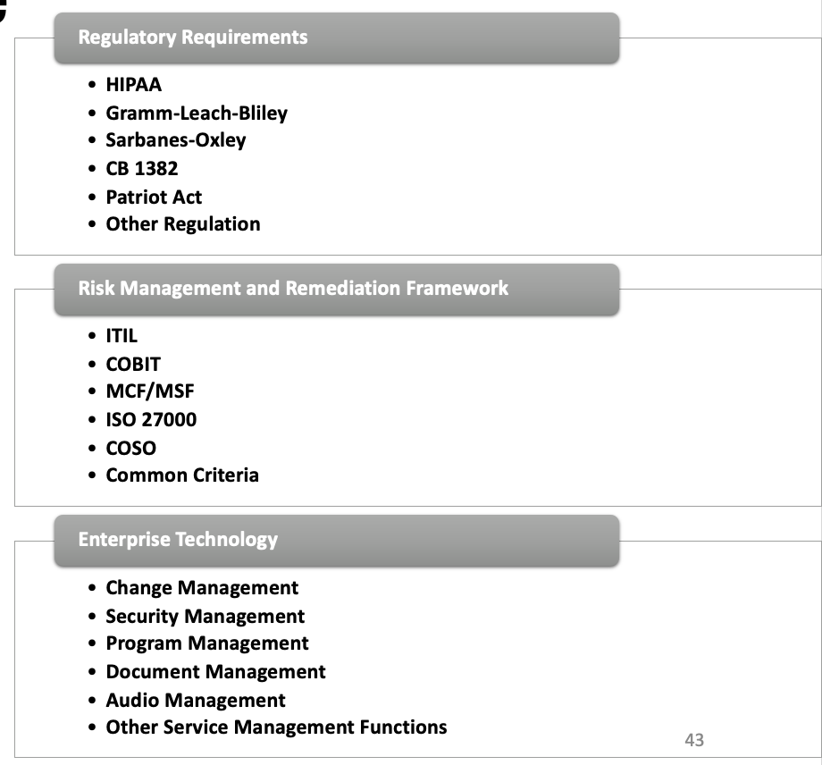
Definition of Compliance
Compliant means conforming to requirements or instructions
Compliant does not mean safe

Slide 44
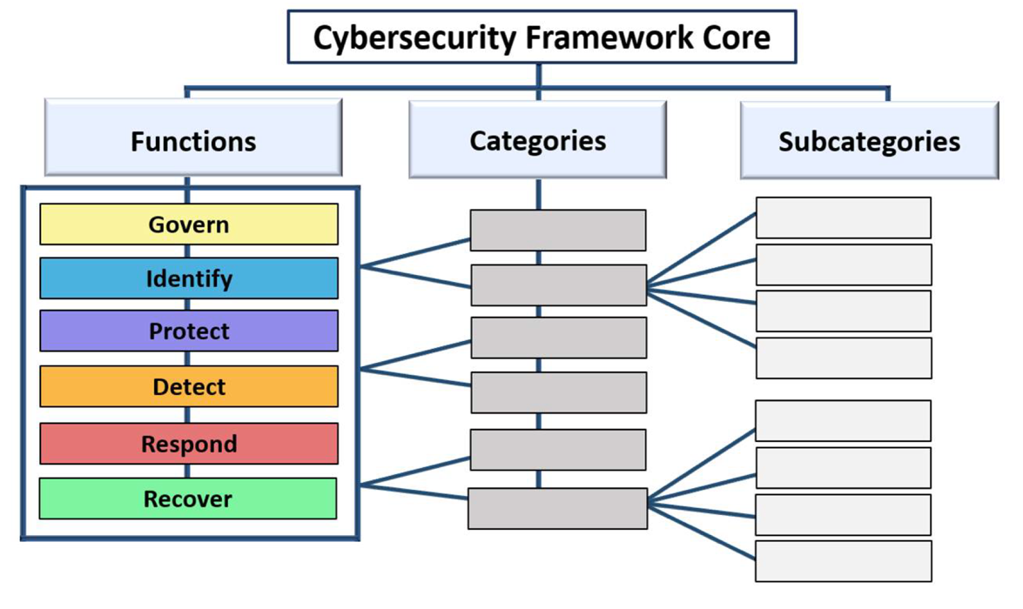
NIST Cybersecurity Framework Core

Slide 45
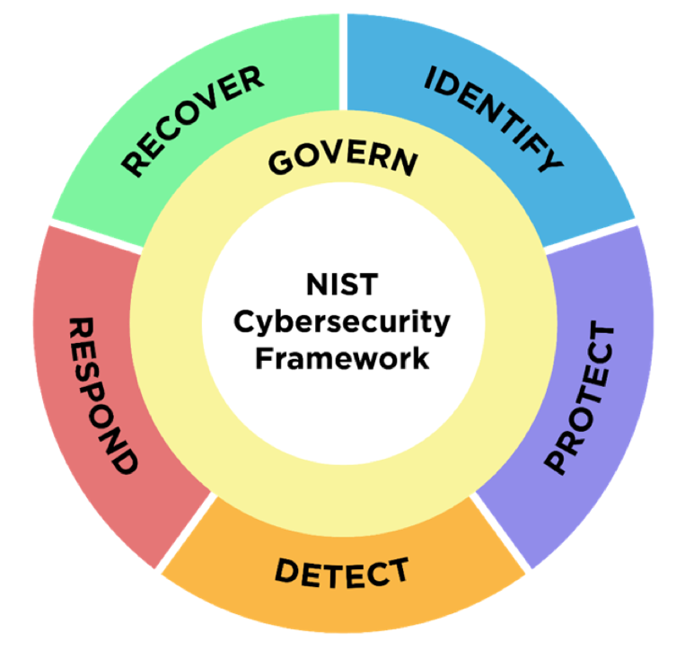
NIST Cybersecurity Framework 2.0
Released February 2024
Added Governance
Establish and monitor the organization’s cybersecurity risk management strategy, expectations and policy

Slide 46
The Six Framework Core Functions
Govern
Outlines an organization’s cybersecurity risk management strategy, expectations, and policies; also describes how they are communicated and monitored
Identify
Develop the organizational understanding to manage cybersecurity risk to systems, assets, data, and capabilities
Protect
Develop and implement the appropriate safeguards to ensure delivery of critical infrastructure services
Detect
Develop and implement the appropriate activities to identify the occurrence of a cybersecurity event
Respond
Develop and implement the appropriate activities to act regarding a detected cybersecurity event
Recover
Develop and implement the appropriate activities to maintain plans for resilience and to restore any capabilities or services that were impaired due to a cybersecurity event

Slide 47
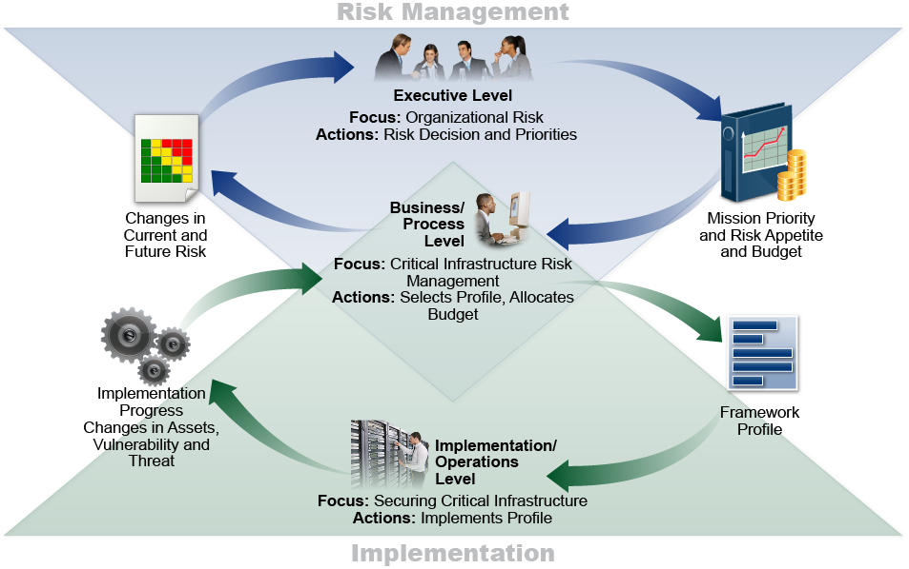
Notional Information and Decision Flows within an Organization

Slide 48
Uses of the Framework
Basic review of cybersecurity practices
Establishing or improving a cybersecurity program
Prioritize and scope
Orient
Create a current profile
Conduct a risk assessment
Create a target profile
Determine, analyze, and prioritize gaps
Implement action plan
Communicating cybersecurity requirement with stakeholders
Identifying opportunities for new or revised informative references
Methodology to protect privacy and civil liberties

Slide 49
What do you see as Banking Tech Trends?
Cloud adoption
Core banking modernization
Digital customer experience
AI and automation
Data analytics
Fintech partnerships
Compliance automation
Cybersecurity and resilience

Slide 50
Summary
Overview of the Gramm-Leach-Bliley Act
Overview of the Fair and Accurate Credit Transactions Act
Dealing with compliance
Governance-based versus technology-based procedures
Planning versus doing
Best practices

Slide 51
Information Security Oversight
Chapter 4

Slide 52
Chapter Objectives
Upon completing this chapter, you will be able to
Identify the functions of IT governance and list challenges to it
Describe Information Security roles and responsibilities
Discuss common approaches to segmenting functions

Slide 53
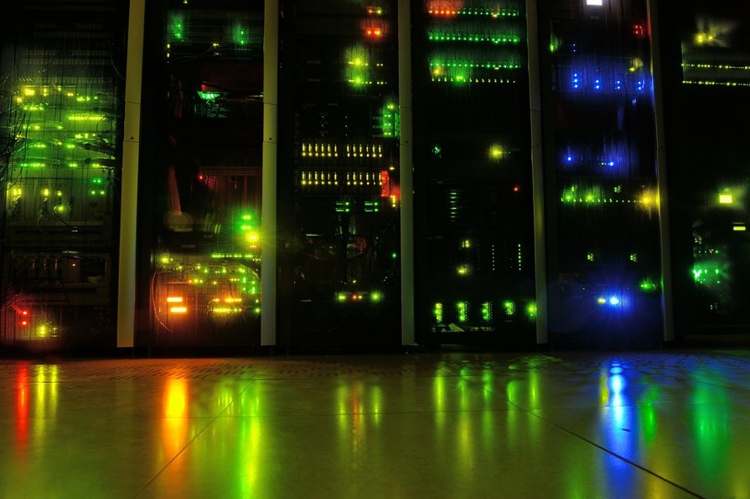
Information Technology
What are the elements of IT?
Computer hardware
Computer networks
Operating system software
Application software
Application data
User data
People
Security

Slide 54
What is IT Governance?
The Gartner Group has a simple definition
“… the processes that ensure the effective
and efficient use of IT in enabling an
organization to achieve its goals.”

Slide 55
Elements of IT Governance
Strategic alignment of IT with the business goals
IT oversight
Project review and prioritization
Resource management
Budgeting
Assigning accountability
Lifecycle management
Risk management
Performance management
Security
Policy, standard and procedure development

Slide 56
How?
Use one, or a combination, of the many governance frameworks
COBIT (ISACA)
ISO/IEC 38500
ISO/IEC 27001(security management)
ITIL
COSO
Size and complexity of the organization and its IT implementation determines the approach to IT Governance

Slide 57
Some Current Challenges for IT Governance
Greater reliance on IT (automation/digital transformation)
Expansion and/or replacement of the capabilities of existing IT systems
Adoption of new technologies
Cloud
Migration
Containerization
Micro-segmentation
AI
Increased data sharing between internal applications and with partners
Managing partners (3rd and 4th parties)

Slide 58
Who Has a Role in IT Governance?
Board of Directors
CIO/CTO
CISO
LoB Heads

Slide 59

Some Things to Consider
Role of IT is expanding in most banks
Digital transformation is key to many community banks
Gain traction with millennials and Gen Z
Expand presence
Increase speed to loan approvals
Reduce costs?
Challenges of preventing/managing shadow IT
Availability of skilled personnel

Slide 60
Summary
IT Roles and Responsibilities
Inhouse deployment and outsourcing

Slide 61
Information Security (InfoSec) Fundamentals
Chapter 5

Slide 62
Chapter Objectives
Upon completing this chapter, you will be able to
Describe the foundations of security
Identify risks and threats for data
Discuss alternatives for handling risk

Slide 63

What are We Afraid Of?
Compliance
Data loss
Sensitive information (customer or supplier)
Intellectual property
Financial loss
Reputation loss
Recovery time

Slide 64

A Few of the Threats
Fraud
IP address spoofing
Automated scanning tools
Trojan horses
Bots and botnets
Packet sniffers
Viruses and worms
Java and ActiveX
Hacked web pages
Insider compromise
Mistakes

Slide 65
Enterprise Security Evolution
1980s focus on the physical protection of information
1990s CIA and consideration of insiders as well as outsiders
2000s risk analysis, proactive monitoring, incident response
2010s automation, deep packet inspection, security as a service
2020s more automation, multiple solutions combined, artificial intelligence

Slide 66
Security Breach Components
Prize
Actor
Asset
Attribute
Action

Slide 67

Actor
External
Hacktivist
Nation State
Criminal
Internal
Malicious
Accidental
Partner
Malicious
Accidental

Slide 68

Asset
Stored data
Online
Offline
User application
Device operating system
Device
Server
PC
Tablet
Smartphone
Corporate network
Internet
People

Slide 69
Attribute
Integrity
Confidentiality
Availability

Slide 70

Action
Malware
Hacking
Social engineering
Misuse
Physical breach
Error
Environmental

Slide 71

Application of Security Services
Security is needed by everyone, everywhere
Examples include
Employees working in any part of the corporation
Offices (branch, regional, headquarters)
Data centers
Stores, manufacturing locations, etc.
Remotely (mobile workers)
Corporate servers and critical systems
Cloud services

Slide 72
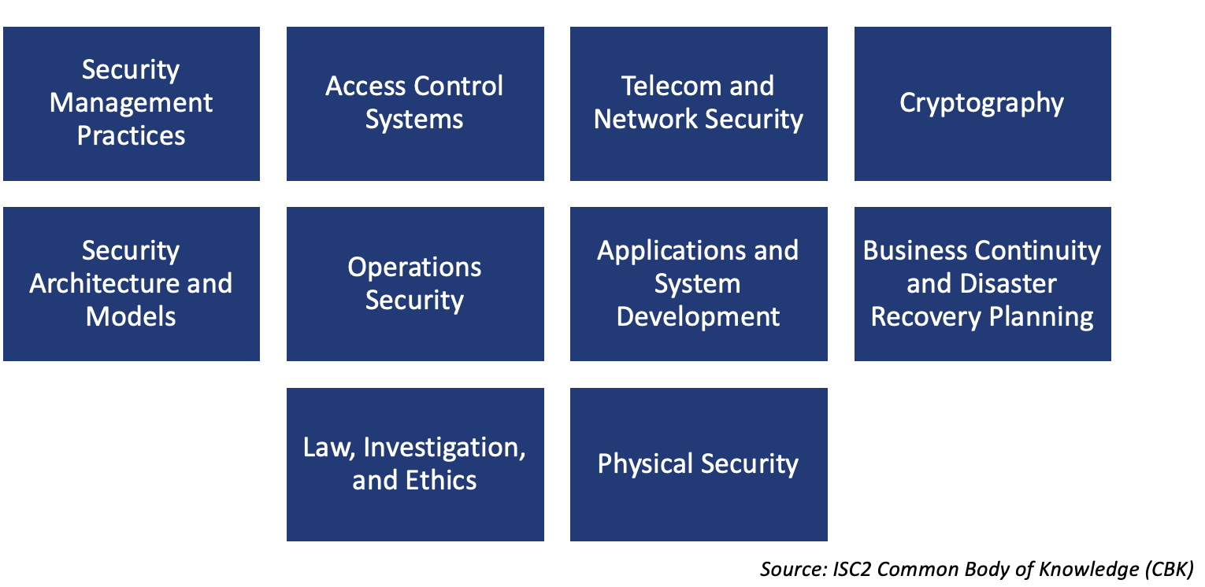
Security Topics

Slide 73
Security Definitions - Review
Vulnerability
Hardware, software, or operational deficiency (bug) that provides opportunity for threat
Threat
A danger to security (confidentiality, integrity, availability)
Anything from an employee mistake to a fire
Risk
Likelihood of threat taking advantage of vulnerability
Exposure
The harm that comes as a result of a threat taking advantage of a vulnerability
Countermeasure
Step taken to reduce risk
Never 100%

Slide 74
System Vulnerabilities in the Old Days
How many keys to the room?
Can I trust the people with the keys?
What about the ceiling type and air vents?
Strength of walls, door, locks?
Electromagnetic patterns?

Slide 75
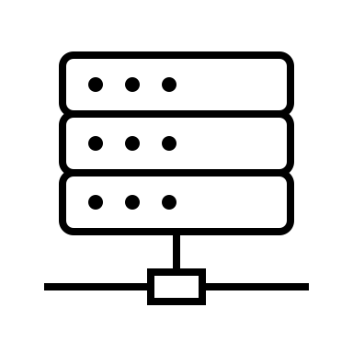
System Vulnerabilities Today
Where is the information?
Who has access?
Which networking protocols are in use?
What holes are there in the desktop Operating System?
What holes are there in the network Operating System?
What applications are in use and their holes?
Where are the applications located (internal, cloud)?
Are our people vigilant?
How will we detect an anomaly?

Slide 76
Cyber Kill Chain
Risks can be depicted in a variety of ways
Event trees
Attack trees
Cyber Kill Chain
And others
Tools depict multi-phasic nature of attacks
Highlight potential areas for mitigation
https://www.lockheedmartin.com/en-us/capabilities/cyber/cyber-kill-chain.html

Slide 77
Mat Honan Hacked
“In the space of one hour, my entire digital life was destroyed.”
Google account taken over, then deleted
Twitter account was compromised and used to broadcast socially unacceptable messages
AppleID account broken into and used to remotely erase all of the data on his iPad, iPhone, and MacBook
Vulnerability: all accounts were daisy-chained together
The flow of the hack
Begins with Amazon
Which leads to AppleID account
Which leads to Gmail
Which leads to Twitter
Countermeasures not used: Two-factor authentication and frequent backups (especially irreplaceable family photos)

Slide 78
The Hack and Hacker Exposed
Phobia, the hacker, communicated with Mat Honan
It all begins at Amazon with a displayed partial credit card number (last four digits) that is used at Apple as part of customer identification along with a billing address
Hacking into Amazon was easy
Call Amazon, identify yourself as account holder and ask to add a credit card
Amazon wants name, billing address, and email address (all of which can be found on most personal websites)
Input a new credit card number (valid fake card numbers can be obtained online)
Hang up and you are done with the first part
Now call back and tell Amazon that you have lost access to your account
Using the ID information from the last call you can add a new email address
Go to the website and request a password reset and it will come to the new email address
Log in with the new password and get the last 4 digits of the credit cards on file
Go to Apple with the credit card digits and you are home free

Slide 79

Phishing is the #1 Attack Approach
Do you have any good examples of fishing?

Slide 80
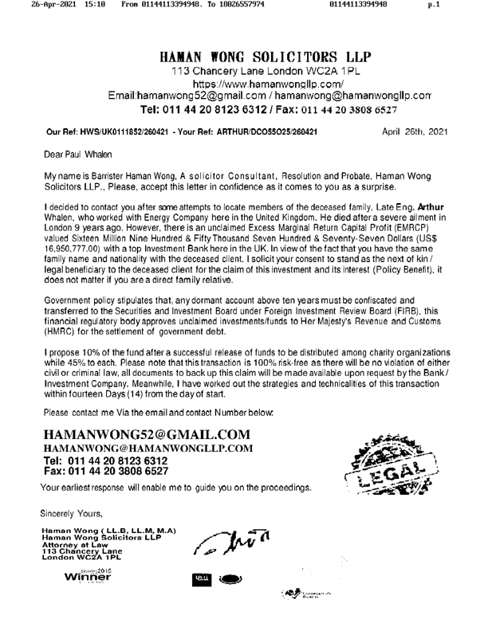

Slide 81

Information Security Tools
Physical controls
“I am physically securing the asset…”
Doors, locks, keys, fences
Administrative controls
“I am telling you…”
Policies
Security
Acceptable use
Staff screening and training
Technical controls
“I am implementing technology to control…”
Firewalls and intrusion detection/prevention systems
Authentication systems

Slide 82
Summary
The fundamentals of InfoSec
The CIA Triad
Sample threats and vulnerabilities
POS breach
DDoS attack
Phishing
Understanding risks and threats
Handling risk

Slide 83
Security Policy
Chapter 6

Slide 84
Chapter Objectives
Upon completing this chapter, you will be able to
Define the need and purpose of a security policy
Examine the steps in security policy development
Describe how to implement an effective security policy

Slide 85

CEO Questions
How are we identifying risks and handling them?
Are we adequately protecting the sensitive data?
What is our ability to mitigate the risks?
Do we fully understand what information we have and its sensitivity?
How are our providers ensuring they mange their systems?
Modified from CSBS Resource Guide

Slide 86
Exercise
List the “digital crown jewels” in your personal computer world
As a group create your answers to the question below and be prepared to discuss in the larger group
Who has access to them?
How secure are they?
What risks are there to losing them?
How are you mitigating these risks?

Slide 87
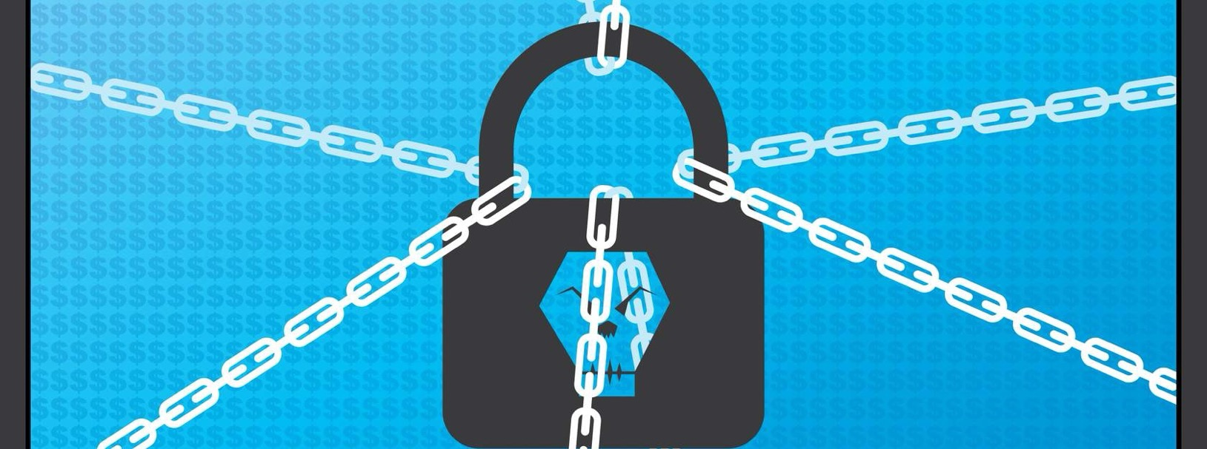
Ransomware
Will your mitigation techniques in the prior exercise work with ransomware?

Slide 88
The Importance of a Security Policy
Policy drives technology
Increases cost-effectiveness
Provides guidelines for uncertain scenarios (incident response)
Consistency of monitoring
Change management to ensure holes are patched
Defines acceptable use
Ensures employees are aware of the threats
Guides operations

Slide 89
Security Policy Is the “Why”
Security policy
Short
Stable
Supports corporate mission statement
Approval from highest level of management
Outline's consequences of non-compliance
Results in a positive cost benefit!

Slide 90
Program Policy
Sets the strategic direction for the Information Security Program
Elements include:
Purpose of the program
Specific focus
Scope
Resources covered
Compliance
Responsibilities
Accountability
Employee role
Service Provider
Consequences for non-Compliance
Communication
Update cycle

Slide 91
Issue-Specific Policy
Guidance on policy addressing specific areas of concern, including:
Internet access
Remote access
Email
Software installation
Policy includes:
Issue definition
Organization’s position
Applicability
Roles and Responsibilities
Compliance and consequences for non-compliance
Where to get further information

Slide 92
System-Specific Policy
Guidance on specific system security program
Dictate security objectives for system use
Direct operations implementation of controls
Objectives must be:
Specific
Clear
Achievable
Practical
Operations security
What may be changed
Conditions under which changes can be made
Who is authorized to make changes

Slide 93

Security Standards: The “What”
Content validity measured against security policy
Quantify the risk
Refer to the risk to business and systems that support the business
Describe the consequence of non-compliance
May refer to other standards, policies and law (e.g., HR, federal and state laws, ISO compliance)
Protect resources
Provide secure remote access
Implement IPSec VPN
Employees
Partners
Define appropriate use
Monitor access logs
Enforce rules, punish offenders

Slide 94
Sample Standards
Business Continuity standard
Third Party Provider management
Cloud standard
Asset management
Access management
Physical access
Configuration management
Incident management
Information classification
Data protection standards
Data steward

Slide 95
Security Procedures: The “How”
Nuts and bolts
Volatile
Content validity measured against “security standards”
The “how-to” manual of security compliance
Examples
Roles and responsibilities
Configuration templates
Check logs daily
Response actions

Slide 96
Security Guidelines: The “Best Practices”
Like standards, but not mandatory
Can be anything
But typically, refinements to either the standards or procedures, or things to consider when implementing an information security program
“Adopted” standard procedures when no formal process exists
Examples
Connect to secure Wi-Fi only
Do not use browser password storage features
Don’t rush into satisfying requests for PII
Always use strong passwords

Slide 97

Standards Enforcing Confidentiality
Physical
Locks
Guards
Walls and fences
Administrative
Password policy
Escorted visitors
Least privilege user accounts
Technological
Encryption
Authentication

Slide 98

Standards Enforcing Integrity
Physical
Secure boots
Employee-only network access
Closed circuit monitoring
Administrative
Separation of duties
Rotation of duties
Mandatory vacations
Technological
Access control matrices
Read versus write permissions
Hash algorithms

Slide 99

Standards Enforcing Availability
Physical
Spare component parts
Secure backup storage
Standby servers
Administrative
Cross training
Relationship with outsourcing company
Technical
Multi-homed Internet connections
Cloud services

Slide 100
Create Procedures Documents
Should be step-by-step documentation of security configuration
Administrative steps
Technical configurations and options
Physical controls and guidelines
Multiple documents specific for each group
Physical plant
IT group
HR policies, etc.

Slide 101
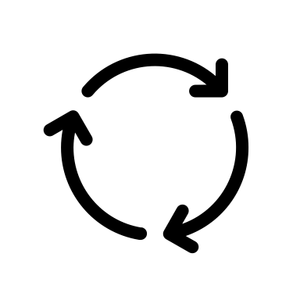
Review and Update Regularly
Change management is the process of defining how changes to the security policy are to be implemented.
Security policy should change only to reflect business mission
Standards and procedures might change more often
Implement change management policy from the start
Review after security related incidents

Slide 102
Summary
The need and purpose of a security policy
Steps in security policy development
Implementation of an effective security policy

Slide 103
Security Management Practices
Chapter 7

Slide 104
Chapter Objectives
Upon completing this chapter, you will be able to
Discuss asset management
Describe seven controls
Access control
Encryption
VPN
Firewall
Device hardening
Network Access Control
Mobile device management

Slide 105

CEO Security Protection Questions
Do we have the appropriate skills and knowledge to protect against a potential attack?
Are the staff informed about cyber threats?
Do they understand the potential risks associated with their actions?
How effective are our policies and procedures for monitoring
Modified from CSBS Resource Guide

Slide 106

Asset Identification
You cannot protect it if you don’t know you have it
First step to protection is identifying what needs protecting
Inventory data may be complex
Asset
Value
Location
Manufacturer
Configuration
Warranty/maintenance plan
Insurer
Replacement options
FDIC Asset Tag 1435672

Slide 107
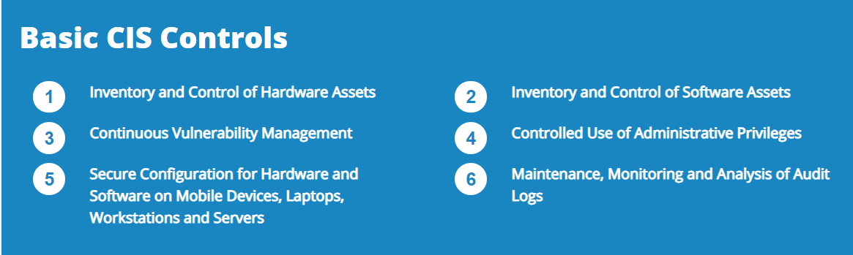
Some Asset Management Challenges
BYOD
Rogue devices
Unauthorized applications
Others?

Slide 108

Countermeasure Implementation: A Layered Approach
Access control
Authentication
Filters
Network address translation (NAT)
Proxy servers
Virtual private network (VPN)
Firewalls
Encryption
Virus protection software

Slide 109

Access Controls
User and data classification
Roles
Sensitivity
Rights management
Internal
Onsite
Remote
Partner/vendor
Customer
Technical and physical access controls needed

Slide 110

Personnel Controls
Implement checks for all employees during
Interviews (e.g., background checks)
Obtain agreements covering confidentiality, non-disclosure, authorized use
Increased accountability (e.g., reviews)
Provide awareness training policy compliance
Post employment (e.g., disable accounts)

Slide 111


Classifying Information
Shorthand way of indicating handling and protection requirements
Link to a protection profile
Example: When encryption is required or physical controls when transporting documents
Should be clearly marked
Can change over time
Review, update
User access controls limit who can see what
Data Loss Prevention (DLP) enforces compliance

Slide 112
User Access Control (UAC)
Maintains
Confidentiality
Only authorized subjects can read objects
Integrity
Only authorized subjects can modify objects
Availability
Only authorized subjects can use objects
“Financial institutions should have an effective process to administer access rights”
- FFIEC Information Security Handbook

Slide 113
Common Terms: Part I
Objects
Passive resources
Files, printers, applications, system resources
Subjects
Active entities (someone or something) that utilize objects
Authentication
Identity verification
Focus: Subject
Access controls control which objects a subject can access
Without it, everyone would be able to access everything on a network, in a database, or on a computer

Slide 114

Common Terms: Part II
Authentication
Proving who you are
Authorization
Access rights
Focus: Subject → Object
Accounting
Auditing/logging
Focus: Subject → Object (access detail)

Slide 115
Role-Based Model
Most common model for computer operating systems
Based on subject role (group) and object class
Hierarchical strategy
For example, security manager is in IT group, which is in employee group
Least privilege strategy
Separation of duties strategy
No one user can abuse the system on his/her own
Users
Roles
Permissions

Slide 116
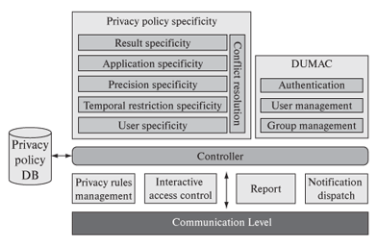
Context-Dependent Access Control
More secure than access control lists
Object access depends on subject context
Access control lists
Dr. Alice has read access to Bob’s patient file
Context-dependent access control
Dr. Alice has read access to Bob’s patient file only if Bob is currently a patient of Dr. Alice
Can also be location based (mobile)
Complex relationships mean complex access control

Slide 117

User Access
Minimize privileges
Only use administrative accounts when needed
Audit privileged account use
Change default account passwords remove account if not needed

Slide 118

Authentication
First step in user access is identifying who they are (authentication)
Authentication requirements vary based on the user and the types of resource they have access to
Critical in limiting access to the secrets
Multifactor authentication is a must today
Optimus Prime

Slide 119

Authentication Factors
Something you know
Something you have
Something you are (biometrics)
For better authentication use multiple factors
My%Pa55Wurd

Slide 120
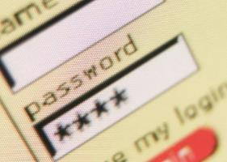
Password Considerations
Length
Minimum/maximum
Complexity
Capital and lowercase letters, numbers, punctuation, no dictionary words
Duration
Expires yearly vs. monthly vs. weekly vs. daily
Scope
Unique passwords vs. same password for multiple systems
Lockout after x failed attempts
Password manager anyone?

Slide 121

Biometrics
No longer science fiction
Provides authentication based on some physical characteristic
Fingerprint (a current favorite)
Hand/palm geometry
Iris pattern
Voice pattern
Facial recognition
False negative/Type I error
Incorrectly denying authentication
False positive/Type II error
Incorrectly allowing authentication

Slide 122
A Conundrum
Security is important
Two factor authentication required
Customers don’t like complexity
Is it okay to trade security for simplicity in a competitive industry?

Slide 123
Third-Party Access
Who is getting in?
Consider non-employees with access
Customers
Vendors and partners
Friends
Consultants
Part-time
Support
Dial-up diagnostic support
Restrict access to network resources
Stop “shoulder surfers”
BYOD policies

Slide 124
Security Can Be Compromised Physically
Security goals can be compromised by physical access and damage
Risks typically mitigated by zone-oriented implementations
Typically focused on data centers, computers, telecom equipment
Goal: Protect against risks from
Physical penetration by malicious/unauthorized people
Damage from environmental contaminants
Electronic penetration
Actively or passively
“Financial institutions should define physical security zones and implement appropriate preventative and detective controls for each zone.”
- FFIEC Information Security Handbook

Slide 125
Secure Areas
Areas deemed critical to protect, confidentiality, integrity, and availability
Protection should be appropriate for risk
Keep logged audit trail for all access
Supervise visitors
Require visible ID
Place support services outside secure areas to limit demands for access (e.g., fax machine, copier)

Slide 126

Material Disposal
Dispose of data carefully
Paper
Disks (data remnants)
Use appropriate contractor to dispose of sensitive material

Slide 127
Cybersecurity Protection
What data are we protecting?
Where is it?
How many copies of it are there?
Are all copies equally secure?
What applications use it?
Where are the applications?
Who has access to the applications?
Are elements of the data used by corporate AI applications?

Slide 128

What are we Protecting?
Cloud
internet
Corporate

Slide 129
Encryption
Encryption is simply making something unreadable without having some specific knowledge (password) or item (like a key).
Most computer encryption systems belong in one of two categories:
Secret-key cryptography
Public-key encryption
Why use encryption?

Slide 130

One Stop Crypto
Information to be sent or stored
Mathematical steps taken to encrypt
e.g., DES, 3DES, AES, twofish, blowfish
Larger key, more combinations, harder to guess (brute force attack)
Using the algorithm and a key to make plaintext unreadable
The information is sent, or stored, in an unreadable form
Convert ciphertext back to plaintext using the algorithm and a key

Slide 131
Thoughts on Cryptography
Performance impact
Hardware-based or software-based
Unfeasible to decrypt without the code
Impractical ≠ impossible
Strong cryptographic systems can withstand attacks up to a point
The mathematics is rarely the weak link!
Cryptography alone cannot guarantee 100% security
Can achieve a high level of risk acceptance
Goal is to balance the possible with the acceptable

Slide 132
Secret-Key Cryptography
Each computer gets a secret key (code) that it can use to encrypt a packet of information before it is sent over the network to another computer
Secret-key cryptography is essentially the same as a secret code that each of the two computers must know in order to decode the information
The code provides the key to encoding and subsequently decoding the message
How do you share the secret key secretly?

Slide 133
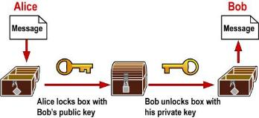
What is a Public Key?
Two keys that are mathematically related but knowledge of one key does not yield (easy) knowledge of the other
One key encrypts; the other key decrypts
Main uses: Key exchange, digital signatures, authentication
Examples
Rivest, Shamir, Adleman (RSA) – prime factors of large number
Diffie-Hellman (DH/DSS) -- exponentiation
Problem: How do we exchange secret keys securely?
Answer: Use a public key

Slide 134
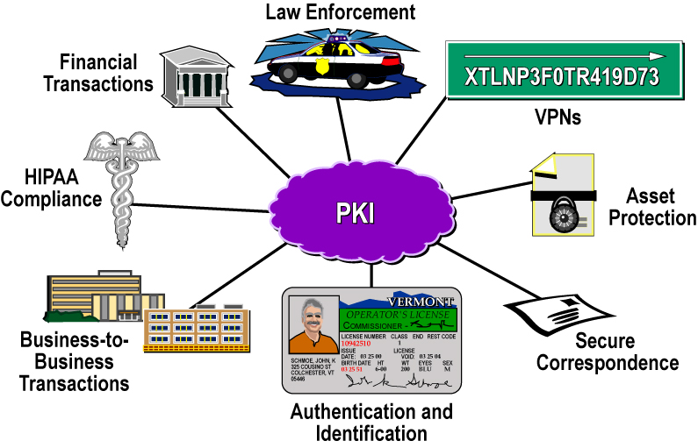
Why Public Key Infrastructure?

Slide 135
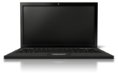
PKI Infrastructure Overview
Certificate Authority
Directory Server
Issues, Signs, Revokes, and Manages Certificates
Issues Copies of Certificates and Certificate Revocation Lists
Network
Users (Client Software Employing Certificate Technology)

Slide 136

Certification
Binding an identity with a public key
3048 0241 00C9 18FA CF8D EB2D EFD5 FD37 89B9 E069 EA97 FC20 5E35 F577 EE31 C4FB C6E4 4811 7D86 BC8F BAFA 362F 922B F01B 2F40 C744 2654 C0DD 2881 D673 CA2B 4003 C266 E2CD CB02
=

Slide 137
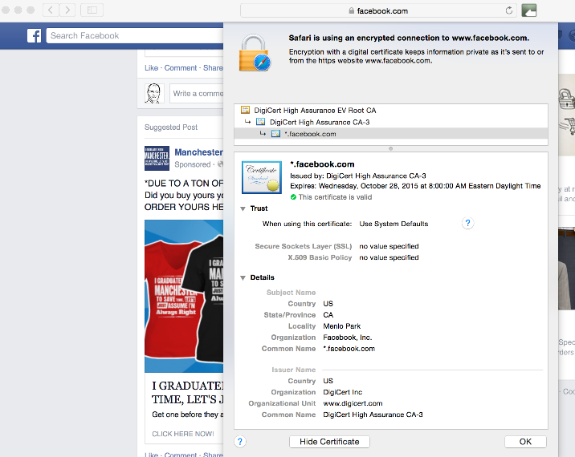
Certificate Example

Slide 138

PKI Operational Considerations: Disaster Planning and Recovery
Keep user base on record for easy notification
Configure client software to check revocation lists
Use keys of shorter duration (1–2 years) to minimize damage from single key compromise
Use key rollover mechanisms to ease recovery

Slide 139
Quantum Computing and Cryptography
A new way to solve certain problems at unprecedented speed
Cryptography is susceptible due to the approaches used in public key cryptography
Potentially our secure data can be cracked wide open
Post-quantum cryptography has been worked on and demonstrated in recent years
NIST is in the process of creating standards, publications due to be released in 2025
Minimally it is time to plan for the age of quantum computing

Slide 140

Passkeys
Ready to eliminate passwords?
Fast ID Online (FIDO Alliance) is a step to this goal
Support from all major OS and browser providers
Introduced late 2022
Adoption began in 2023 and expected to accelerate in 2024
Combines identity, device, public key cryptography and biometric (or PIN) for authentication
Anyone here using Passkeys?
Any banks you are aware of?

Slide 141
Virtual Private Networks
Provide remote access to the corporate network for employees
Inexpensive option for building a private network
Allows trusted partner access to private network
AAA used for access
Public key cryptography used to exchange private session keys

Slide 142


Virtual Private Network (VPN)
Creating privacy over a public network
Provides a logical connection (tunnel) across a public infrastructure (Internet) between two devices that can be encrypted and authenticated
VPN drivers
Reduced cost
Geographic reach
Mobile workforce
Teleworkers
internet
Secure tunnel

Slide 143




Three VPN Models
Premises
internet
Premises
Site-to-Site
VPN Client
Host-to-Site
VPN Server
Host-to-Host
VPN Client
VPN Server

Slide 144
Wide Area Networks
Wide Area Networks (WAN) connect a business’s locations

Slide 145

Private Line Networks
Old school approach to building a private WAN
Rare in 2025
Privacy provided by using dedicated point-to-point circuit from the telecommunications provider, such as a T1
Dedicated Private Line from Branch to HQ

Slide 146




Multiprotocol Label Switching (MPLS)
MPLS provides connection within a service provider’s network
Does not use the internet
VPN
VPN

Slide 147
Internet VPN WANs
Site-to-site VPNs offer a low-cost WAN approach
Used to connect branches and service providers (partners)
Large networks require lots of manual configuration
Tedious, exacting work
Potential for mistakes
internet
Site-to-Site VPN

Slide 148
Software Defined WAN
SD WAN fastest growing WAN technology
Developed in response to:
Need for simplified configuration (orchestration)
Cloud application addition/migration
Desire for greater network visibility
Growth in importance of digital assets drives business continuity requirements
Offers ability to create hybrid of private and VPN
Most SD WAN implementations use internet VPNs and ditch any remaining MPLS
Use of multiple internet service providers provides for business continuity

Slide 149
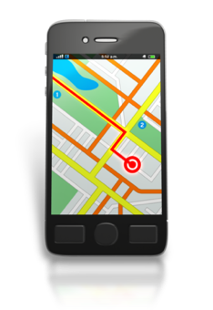
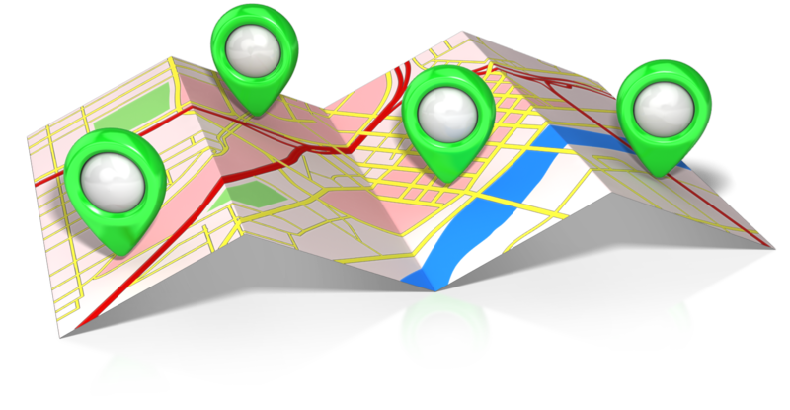
Software Defined Wide Area Networking - Concept
Centralized software control (overlay)
Multiple routes/networks
(underlay)

Slide 150





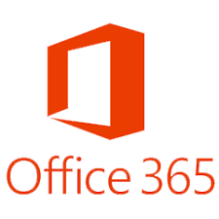

SD WAN Example
Inventory
ISP 1
ISP 1
SD WAN
CPE
SD WAN
CPE
ISP 2
Internet
ISP 2
Uses two or more internet connections
Common approach to Business Continuity

Slide 151
Firewall Definition
A device that connects a trusted network or device to an untrusted network. The firewall protects the trusted network or device while providing restricted connectivity to and from the untrusted network, according to a security policy
Protected Network
internet

Slide 152
Firewall Options
Application-level gateways
Proxy servers
Application specific
Can provide user authentication
Increasing level of protection and cost
Stateful inspection
Multi-layer
Deep analysis of packet relationships
Increasing level of protection and cost
Packet filters
Network Layer
Typically implemented in routers

Slide 153
Packet Filter
Simple, powerful protection
Filter packets based on rules
Access Control List (ACL) in Cisco terminology
IP Packet
Permit
Check
ACL
Deny

Slide 154
Stateful Inspection Firewall
Stateful inspection
Application Layer unaware
Monitors flow of TCP
UDP tracking
Allow outbound Port 80 connections
Block outbound Port 80 connections
Active Connections
Source IP | Source Port | Destination IP | Destination Port

Slide 155
Application Layer Inspection
Also known as application-level gateway
Typically occurs in application-specific device
Examples
Email antivirus
Content filtering
Originally standalone devices based on the application
Today part of a multi-featured firewall
May be physical device on site or hosted in the cloud

Slide 156
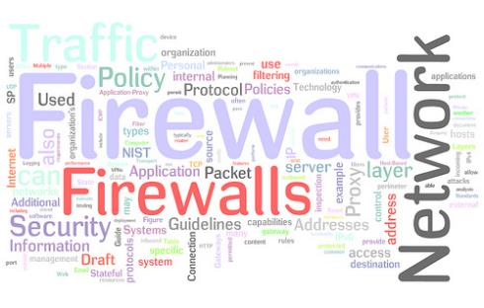
Prudent Policy
Easier to identify what is allowed than what is not
Clearly identify what is supported
Security policy
Applications supported by business
To customers
To vendors
Block everything else!

Slide 157
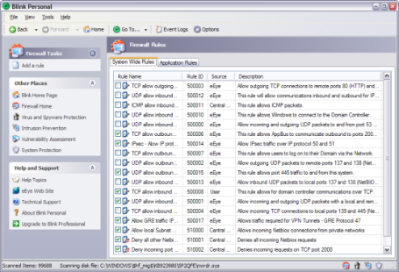
Block the Not So Obvious
From outside
Source address should not be yours, private, unallocated, or broadcast
From inside
Source address should be your allocated block, period
Others
Block source routed frames

Slide 158


Demilitarized Zone (DMZ)
Part of a network that allows controlled access from the Internet
More controlled than open access
Less controlled than private network
Web servers and mail servers often placed here
Referred to as sacrificial servers

Slide 159

Security Zones
Demilitarized zones are used as a buffer between the trusted (internal) network and the untrusted network (Internet)
Internal network maybe further segmented into security zones, segmentation based on:
Application (voice versus data)
Function (teller versus wire transfer)
Wired versus wireless (may include segmenting internal and guest network)
A variety of technologies can be used:
Physical device/network separation
Logical separation (VLANs)
Firewalls may be used between zones

Slide 160
Firewall Reality Check 2025
Multifunction capabilities now the norm
Unified Threat Management (UTM)
Implemented in hardware or software
On premises or hosted
Usually, comes with ongoing threat update/monitoring service
Online portal provides clean view of incident logs
Maybe a managed service

Slide 161
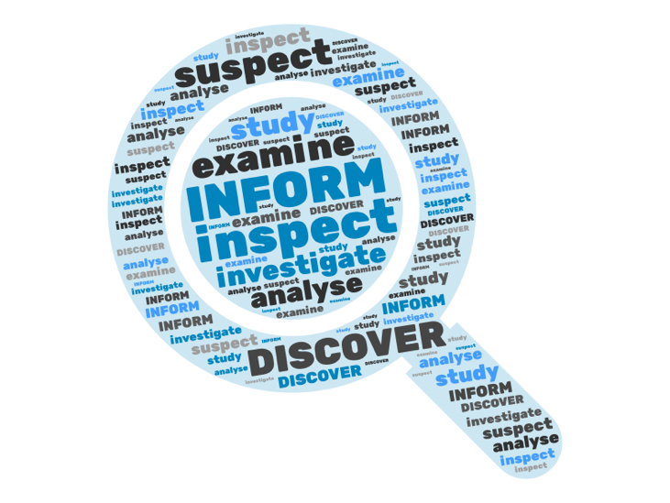

Increased Detection Capabilities
Cloud based threat identification
Machine Learning/Artificial Intelligence
UTM/Firewall

Slide 162
Virtual Network Services
Virtualization can be applied to network functions (VNF)
VNS offers a wide range of capabilities
Hosted and/or on premises
Flexible, scalable and cost-effective
Routing
Firewall
VPN
OS
OS
OS
Hypervisor
Hardware

Slide 163



Secure Access Service Edge (SASE)
Term coined by Gartner is 2019, grown in importance with digital transformation
Use varies by vendor, but there are many common elements
S
A
S
E
SD WAN
Cloud
ZT
SWG
Corporate
FWaaS
internet

Slide 164
Zero Trust Access
Access controls are a critical part of a security plan
Remote access involves Authentication, Authorization and Accounting
Traditional VPN connects you to the corporate network and assumes you are you after authentication and provides full access
Zero Trust places additional protection to key resources
Creates a model of normal workflows and may identify threats by identifying suspicious behaviors (machine learning)
A fast-developing area

Slide 165
Secure Web Gateway (SWG) and Firewall as a Service (FWaaS)
Similar, but different maybe combined in a single solution
SWG is a layer 7 device protecting the enterprise
Application aware
URL filtering
Antivirus/Anti-malware
Data Loss Prevention (DLP)
DNS threat prevention
FWaaS (aka NGFW, WBFW) also includes
Deep Packet Inspection
Traditional FW capabilities
Terminology is confusing and inconsistent, do not be afraid to ask what they mean by a term.

Slide 166

Security as a Service
Individual, or comprehensive sets, of security capabilities may be provided in the cloud as well as on premises
Services may protect services in the cloud, on premises, or the entire enterprise
Hybrid premises and cloud approaches may also be found

Slide 167

Baseline Configuration
Establish and maintain baseline configurations for all device types
Implement automated (controlled) patch management scheme
Limit admin rights on on systems
Store master images offline

Slide 168
System Hardening
A process of securing a system by reducing its surface of vulnerability
System hardening works to reduce the number of functions a system can perform
Since “out-of-the-box” systems are designed for ease of use, and not security, measures must be taken
Removing non-essential software
Addressing “back-door” access issues
Depending on the operating system, manufacturer of the software
File system access
Access audit trails

Slide 169
Sample System Hardening Checklist
Most all system hardening efforts follow a generic process
Perform initial system install
Remove software that is not likely to be used
Disable or remove unnecessary usernames and passwords
Always change the default password
Disable or remove unnecessary services
Apply security and functionality patches
Load security agents

Slide 170
Network Access Control
Designed to protect enterprise networks from the Internet
Can also provide protection from malware that may be living on mobile devices
NAC places a virtual shield around a network by guarding its endpoints
Complex endpoint security programs use NAC to grant authenticated access to user devices
Validating user credentials
Scanning the device for policy compliance
NAC elements may include approved operating systems, firewalls, VPN, current anti-virus software
May be part of a Zero Trust solution

Slide 171
Portable Devices
Laptops
Phones
Tablets
Convenience primary driver
Security a major challenge
Device
Application
User

Slide 172
The Enterprise Challenge
Corporate issued devices only
BYOD
Combination
Bring Your Own Device (BYOD) a struggle for CIOs
Allows convenient access for employees to corporate data sources
Expensive devices provided by the employee
Creates potential security challenges
Corporation does not own or control the device
Hard to enforce security policies if you do not own the device
Malicious applications growing

Slide 173
The Need for Mobile Device Management
Mobile device management requirements are similar to other device types, you require
Strategy
Policies
Monitoring
Compliance requirements growing as government agencies adapt requirements to incorporate mobile devices
Need to manage the devices as corporate assets while controlling the data and applications that run on them

Slide 174
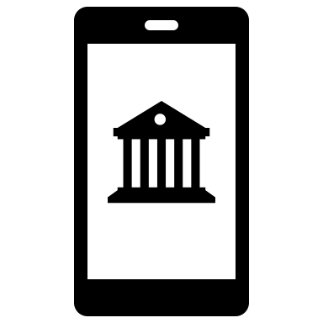
Mobility and Banking
Mobile banking
View account balances
View transaction history
Initiate account transfers
Remotely deposit checks
Pay bills
Locate branches
Mobile payments
Initiate payments with mobile device
Point of sale terminal
Person to person

Slide 175
Summary
Asset management
Access control
Encryption
VPN
Firewall
Device hardening
Network Access Control
Mobile device management

Slide 176

Vendor Management
Chapter 8

Slide 177
Chapter Objectives
Upon completing this chapter, you will be able to
Describe the motivation for engaging a vendor
List some considerations for three vendor types

Slide 178



Outsourcing
Common approach in banking
Banking applications just one piece of the puzzle
General business applications also third-party provided
Concerns:
Cybersecurity
Reputation
Business continuity
Regulatory observance
Confidentiality
Tools
Non-disclosure agreement (NDA)
Service level agreements (SLA)
Access to vendor audit results

Slide 179

Why Outsource?
Can be a cost-effective solution
Preserve capital
Reduce operational expenses
Access to scarce skilled resources
IT resources are expensive and in demand
Hard for a community bank to attract and maintain
Allows focus on the core business, not the chore business
Responsibility stays with the bank
Day to day items like patching move to the provider

Slide 180
Cloud Service Model
Colo
IaaS
PaaS
SaaS
Access Controls
Application
Application
OS
OS
Hypervisor
Hypervisor
Hardware
Hardware
Facility, power, rack, environment controls, fire control
Responsibility
Customer
Provider

Slide 181
Cloud Reality
Maintaining private data centers is complex and expensive
Cloud service provider scale can offer significant savings
Businesses have many applications in the cloud
Microsoft 365
Salesforce
Corporate website
Many businesses are migrating some, or all, of the remaining applications to the cloud
Typically a multi-year multi-cloud initiative
FDIC DIT is a case in point

Slide 182
Security Concerns with Cloud Migration
Concerns are generally the same as for internal systems but become more complex as a 3rd and possibly 4th party are involved
Key areas to examine
Handling of sensitive data
Access management
Cloud configuration
Data backup and replication
Cloud service provider (CSP) security risks
Definition of CSP and bank roles and responsibilities
Encryption
Contract exit criteria and terms

Slide 183
Managed Security Service Providers
One of the most important and common SPs for smaller banks
Core services include:
Security Monitoring
Threat Detection and Response
Vulnerability management (scans, penetration tests)
Firewall and VPN management
Anti-virus and anti-malware
Compliance support
Some support training and testing employees on security

Slide 184
Let’s take a look at a few MSSPs
At your table, research an MSSP and see what they do, and how. You can glance at them all, but you need only “report” on yours.
I’d like you to tell us:
What did you think of this company’s pitch?
What surprised you about them? Anything particularly impressive?
Would you be happy to see them at a bank you examined?
No stress, you don’t need to make a slide deck! Just informal thoughts and impressions.
Group assignments:
Group 1: SBS Cybersecurity https://sbscyber.com/
Group 2: Arraya Solutions https://www.arrayasolutions.com/
Group 3: Palo Alto Unit 42 https://www.paloaltonetworks.com/unit42
Group 4: Optiv https://www.optiv.com/
Group 5: SilverSky https://www.silversky.com/

Slide 185

Generative AI
A form of AI
Capable of creating new content from existing data
Machine learning used to create the learning model
Generative network and transformers generate new realistic output
Many examples including ChatGPT
Content forms can include text, images, music, audio, video and computer code

Slide 186
Large Language Models
Used in GenAI
Trains on massive amounts of data
570 GB in ChatGPT
750 GB (1.56 trillion words) in Google Gemini
Generates new content
Learns patterns and predicts what follows based on the model
Systems starting to look at multiple predictions before providing answers (intelligence?)

Slide 187
Business Applications of GenAi
Content creation and marketing
Customer support
Chatbots
Email automation
Software development
GitHub Copilot
CodeWhispers
Financial transaction analysis
Loan decision making
Compliance testing
And…

Slide 188
AI Security Concerns
Exposure of sensitive data
Bias in the data and decisions
Misinformation
Use in cybersecurity attacks
Phishing
Deep fakes
Data poisoning
Copyright and Intellectual Property violation
Compliance

Slide 189

Use Cases for GenAI in Banking
Loan and mortgage processing
Anti-Money Laundering (AML)
More precise identity verification
Automated customer support
Risk management
Enhanced cybersecurity

Slide 190
Things to Consider
How is AI being used?
Are they managing risk? (Do they use the NIST AI Risk Management Framework or some equivalent)
Do they have AI policies? Are employees aware of these policies and what they mean? (training)
Are the tools unbiased? How is this tested?
How is sensitive data (e.g., PII) protected?
Is the AI autonomous or is there human oversight?
Anything I missed?

Slide 191
Telecommunications Provider (Carrier)
Private data, Internet and voice services
Contracts vary significantly from provider to provider and by service
Know your vendor
Things to look for:
Data encryption
Business continuity options
Security offerings
Service monitoring (provider and customer options)
Outage notification
Filing a claim

Slide 192
IT/Phone Provider
Many businesses use local IT and phone vendors
Support the community
Things to look for:
Industry skills
IT/Phone skills
Certifications (past, ongoing)
Reputation
Availability
Knowledge of compliance requirements
Monitoring services

Slide 193
Summary
Motivation for engaging a vendor
Considerations for three vendor types

Slide 194
Monitoring and Incident Response
Chapter 9

Slide 195
Chapter Objectives
Upon completing this chapter, you will be able to
Describe Intrusion Detection and Prevention
Discuss Security Team principles
Discuss incident responsiveness

Slide 196

CEO Detect Questions
Are we prepared to limit the damaged caused by any attacks?
How is executive leadership informed about current security risks to our company?
Modified from CSBS Resource Guide

Slide 197

Ongoing Monitoring
Protect provides the tools to repel attacks
Attacks are continually evolving and morphing
Detection tools proactively monitor to identify anomalies
Generating and reviewing data is essential
Identify who needs to know in case of an event

Slide 198

Intrusion Detection and Prevention
Acts on activity at the edge or inside the network
Presumes peripheral defenses breached
Or activity originating from inside
Intrusion detection system (IDS) identifies unauthorized or unusual access and then alerts based on severity
Intrusion prevention system (IPS) as well as alerting also acts immediately on stopping the activity
Today functions hard to separate in UTM solutions

Slide 199
Host-Based vs. Network-Based IDS
Host-based
Network-based
Protects individual servers
Usually protects against accidental or malicious actions
File deletion
System configuration changes
File manipulation
Includes monitoring and processing
CPU and disk usage
Syslog
Event logs
Potential for trail to be covered
Monitors a network or LAN segment
Requires sensors in promiscuous mode
Monitors traffic to detect attacks or other suspicious activity
Does not require per host configuration
A plus where servers belong to different departments
Effective ROI
Not dependent on host integrity for operation

Slide 200
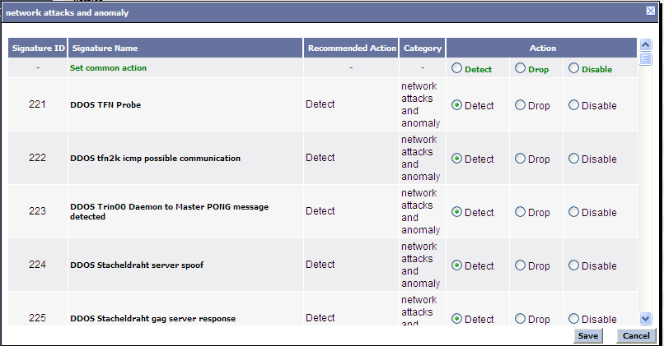
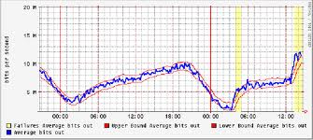
Signature- vs. Statistical-Based
Signature (knowledge-based)
Relies heavily on a database of known attacks and anomalies
MUST be kept up-to-date
Cannot detect what is not in database
Statistical (detects anomalies)
Baseline sample of what is normal
Deviations are suspicious
Can protect against unknown attacks
Helps in Day 0 attack vectors
Uses machine learning (ML) and artificial intelligence (AI)

Slide 201

Managing the IDS
This can be complex; nothing is perfect
Filtering false positives
False alarm → noise
An annoying distraction
Tuning false negatives
Missing the real thing!
Experience will be a guide
Tracking normal behaviors (ML) and AI improve identification of suspicious activity

Slide 202
Endpoint Detection and Response (EDR)
Monitors activity at endpoints
Analyze this data to identify threat patterns
Automatically respond to identified threats
Combines
Endpoint agent
Cloud analysis (ML/AI as used in modern firewalls/UTM)

Slide 203
eXtended Detection and Response (XDR)
Extends the data collection and correlation across the enterprise
Integrates data from multiple sources
Improves detection of advanced threats
Provides greater awareness of security status
May lower total costs

Slide 204
Role of Network Auditing and Monitoring
Auditing is preventative
Vulnerability testing
Network scanning
Monitoring is detective
Log analysis
IDS
File/system integrity checker
“Management should develop and follow a formal internal audit program consisting of policies and procedures that govern internal audit functions, including IT.”
- FFIEC Audit Handbook

Slide 205

Choosing an Auditing Consultant
“In-house” vs. “farm-out”
Expertise level
Familiarity level
Confidentiality level
Independent view
Important considerations
Track record/experience
Non-disclosure agreement
Depth of audit
All systems vs. subset (criticality)
Network only vs. enterprise-wide

Slide 206
Vulnerability Testing
Know your infrastructure’s vulnerabilities
Administrative
Physical
Logical/technical

Slide 207

Testing Administrative Vulnerabilities
Staff awareness
Education
Adherence to policy
Policy
Understandable
Enforceable
Comprehensive
Changeable

Slide 208

Testing Physical Vulnerabilities
Access
Entry barriers
Locks, doors, guards
Equipment
Damage
Man made
Access controls
Natural causes
Fire extinguishers, raised floors

Slide 209
Testing Technical / Logical Vulnerabilities
Software patching
Network scanning
Examine patch levels
Operating system
Applications
BIOS/firmware
Maintain version catalog of all software
Browse vendor sites for vulnerabilities
Subscribe to auto-update feature or update notification feature
Port scanning
Active hosts
Well-known open ports
Example: Nmap
Vulnerability scanning
OS fingerprinting
Application versions and banners
Exploit testing
Example: Nessus

Slide 210
Vulnerability Scanning
Scanning used to identify weaknesses
Scans can be authorized (credentialed) or unauthorized (non-credentialed)
Authorized scanning
Uses credentials to scan deeper into the systems
Identifies missing patches, configuration issues and weak passwords
Unauthorized scanning
Simulates external attack
Identifies external threats such as open ports and outdated software

Slide 211
Pros and Cons: Authorized and Unauthorized Scans
Feature | Authorized Scan | Unauthorized Scan
Access | Internal deep system access | External (surface) access
Purpose | Find application and system vulnerabilities | Simulate external attack
Capability | Patch level (OS, apps), misconfigurations, poor passwords | Open ports, exposed services, outdated software
Use case | Compliance and audit | Pen testing (external risk analysis)
Risk | Credential management, scan time | Low
Which approach should I use?
How frequently should I scan?

Slide 212
Monitoring Ethics
Difficult balance between security and privacy
Sensitive activities
Network sniffing
Activity logging
Web, email, financial and healthcare sites
Legal issues
Monitoring must be documented
Acceptable use/privacy policy
Login banner
Employee education

Slide 213

Audit Reports
Executive
High-level description of issues discovered
May be grouped into categories
Severity
Consequences
Solutions
Technical
Detailed list of vulnerabilities and fixes
Specific issues at OS/application level
Appropriate patches to install

Slide 214

CEO Response Questions
What would we do if we were hacked today?
Have we created an effective response plan? How often is it tested?
Do we have a plan to inform internal and external stakeholders?
Modified from CSBS Resource Guide

Slide 215
When Things Go Wrong
Technology can only go so far in detecting attacks
IDS, firewalls, or other management protocol signals alarm
Humans with understanding of networks must be attentive for strange (abhorrent) events
Strange or missing files
System crashes
Unusual memory/CPU usage
More ways than technology to crack a network
Phone calls

Slide 216
Security Administration Team
Need representation across departments
Or at least input
Need clear reporting structure
Outline responsibility
Establish ongoing accountability
Monitors and audits security measures
IT administration
Does not develop policy, it implements it
These members are facilitators, not necessarily the final decision makers

Slide 217

Incident Response Teams
Akin to “fire wardens”
Trained, experienced personnel in responding to incidents
Clear authority and responsibility defined
Know who to contact when
Members keep telephone list with them
Interface to the media
Have authority to make production-affecting decisions in management's absence
Fill other functions within organization (not needed when things are going well)
Satisfies requirements of FDIC part 364 Appendix B, Supplement A, “Interagency Guidance on Response Programs”
http://fdic.gov/regulations/laws/rules/2000-8660.html#fdic2000appendixbtopart364

Slide 218
Incident Response Plan
Hypothetical: The server goes down! Now what?
Detect
Evaluate
Seriousness
Urgency
Contain
Isolate resource
Investigate
Might depend on above
Eradicate
Restore
Post mortem
Legal counsel should review

Slide 219
Incident Response
Goal is to limit or prevent damage
Includes plans for different types of attack
Maybe automated or manual
Includes communications to key parties
Leadership
Stakeholders
Shareholders
Partners
Customers
Insurance providers
Regulators
Law enforcement

Slide 220

Incident Response Phases
Prepare
Detect
Containment
Short term
Long term
Eradication
Recovery
Review

Slide 221

Incident Response Postmortem
Post incident is a good time to review
Lessons learned
Decision to prosecute
Update documentation

Slide 222
FDIC Incident Response Job Aid
Job aid handout outline procedures for responding to cyber incidents at FDIC supervised institutions or their service providers
Guidance also can be found using the links in the earlier slide outlining FDIC resources

Slide 223

CEO Recovery Questions
When did we last test our recovery plan?
Does the incident response plan include steps for recovery after an attack?
How will we communicate to staff, customers, partners, regulators and law enforcement?
Modified from CSBS Resource Guide

Slide 224
Recovery Plan
Infrastructure
Plan to recover hardware and configurations
Vendor contracts for critical hardware replacement
Maintain up to date images offline
Data
Reliable backup of data should be maintained and tested
Recovery time needs to be considered
Services
SLAs with network and utilities

Slide 225
Preparedness Audit
Auditing the preparedness plan can help ensure you are ready for an event
Elements to include
Review and update breach response team contact list
Review plan for completeness and update as needed to incorporate changes
Review vendor contracts
Review notification guidelines
Check third party management of any data and their response plans
Ensure access controls are in place and monitored
Validate software patch (update) policies are effective
Verify backup data is good and safe
Review staff awareness
Modified from Experian Data Breach Resolution’s Breach Response Guide

Slide 226
Summary
Response plan requirements
Auditing the response plan

Slide 227
Closing Thoughts
Build a culture that is security aware
Training
Testing
Communicating
Patch everything
Use strong authentication and concept of least privilege
Encrypt everywhere possible
Backup data regularly
Deploy strong perimeter and endpoint protection and detection
Segment network
Support the security of remote workers

Slide 228
Closing Thoughts IT Initiatives
Cloud migration
Relocation of applications to cloud service provider (CSP)
Roles and responsibilities have changed (policies, procedures, contracts)
Governance
Cloud security assessments
Compliance
Use of AI
Privacy
Access management
Bias
Compliance
Explainable, transparent AI decision making
Update to stay current with regulation

Slide 229

Thank You! matt@hillvt.com

